Slide 1


MUSIIC STORE ANALYSIIS
Author: Viraj N. Bhutada

Slide 2



Greetings and welcome to our SQL Music Store Data Analysis project—a pragmatic exploration into the heart of our business data. In this initiative, we've employed SQL to dissect and understand the nuances of our dataset. Our goal is simple yet impactful: to extract valuable insights that will guide our decision-making process. This project is all about translating raw data into practical knowledge, shedding light on customer behaviors and industry trends. As we navigate through the project, we aim to deliver actionable intelligence that can contribute to the strategic growth of our music store. Let's delve into the details and uncover the meaningful stories our data holds.

Slide 3



OBJECTIVE
The primary objective of this SQL project is to facilitate sustainable business growth for the music store by addressing existing challenges through a meticulous examination of its dataset. Utilizing SQL, we aim to answer crucial business questions and provide actionable insights. By distilling complex data into meaningful intelligence, our goal is to empower the music store with a strategic understanding of its growth trajectory, enabling informed decision-making and fostering long-term success.
The relational database management system (RDBMS) employed for query execution is POSTGRESQL.

Slide 4

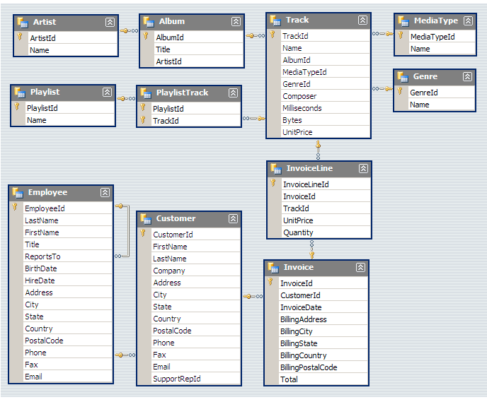

MUSICAL PLAYLIST
DATABASE SCHEMA
Please note that the 'album' table is referenced as 'album2' in the database.

Slide 5






TO STREAMLINE THE ASSESSMENT PROCESS, QUESTIONS HAVE BEEN METICULOUSLY CATEGORIZED I NTO THREE TIERS OF COMPLEXITY:
EASY MODERATE ADVANCED

Slide 6


Slide 7
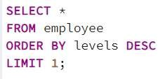
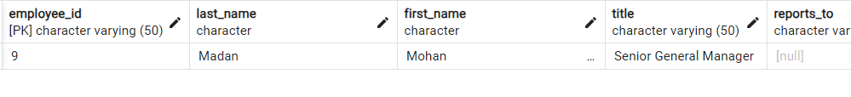
1. Identify the most senior employee based on their job title.

Slide 8
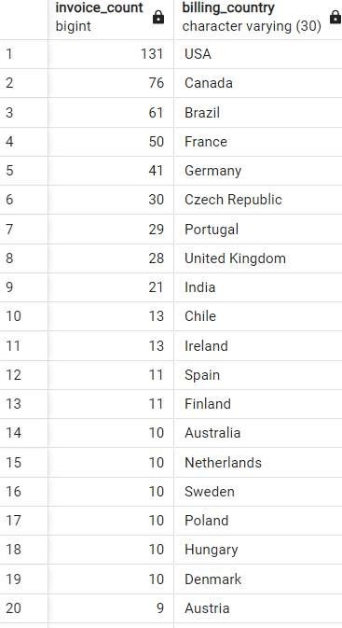

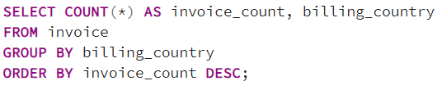



Slide 9
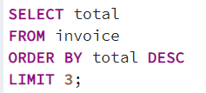
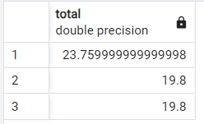

3. Retrieve the top three values of total invoices.

Slide 10
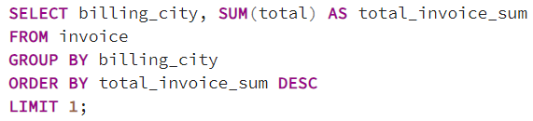
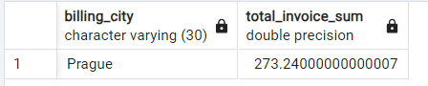
4. Identify the city with the highest sum of invoice totals, as we plan a promotional Music Festival.

Slide 11
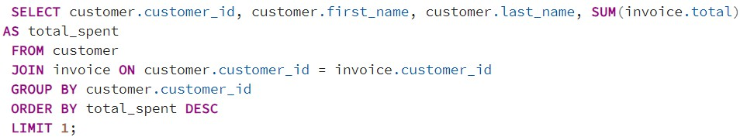
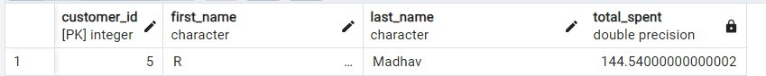
5. Find the customer who has spent the most money.

Slide 12

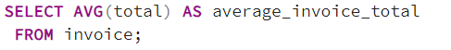
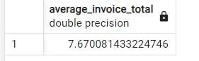
6. Determine the average total for all invoices.

Slide 13
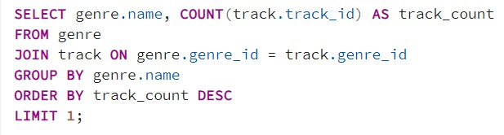
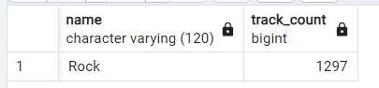
7. Which genre has the highest number of tracks in the database?

Slide 14
QUESTION SET 2 – MODERATE

Slide 15
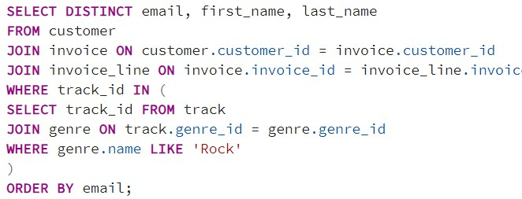
1. Retrieve the email, first name, and last name of all Rock Music listeners, ordered alphabetically by email.

Slide 16
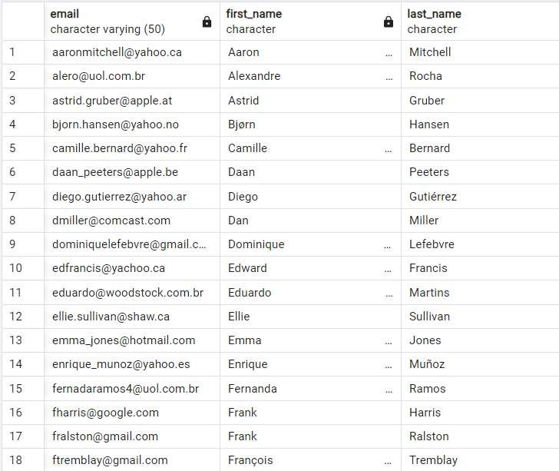
OUTPUT

Slide 17
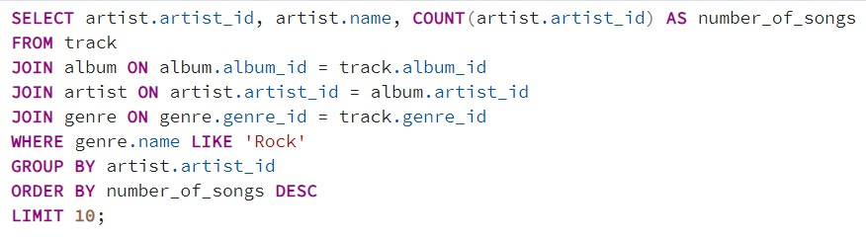
2. Identify the top 10 rock bands based on the total number of tracks they have written.

Slide 18
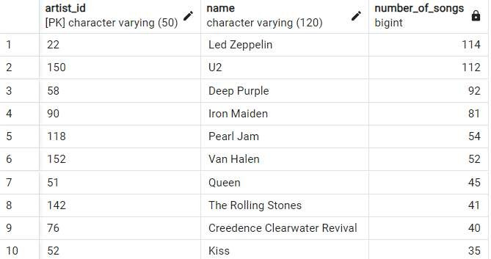
OUTPUT

Slide 19
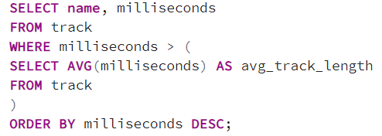
3. Retrieve track names and milliseconds for tracks longer than the average song length.

Slide 20
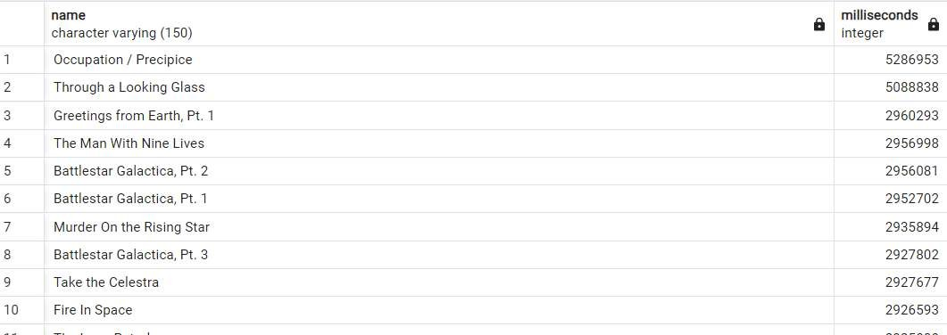
OUTPUT

Slide 21
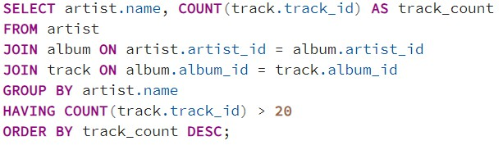
4. List all artists with albums containing more than 20 tracks.

Slide 22
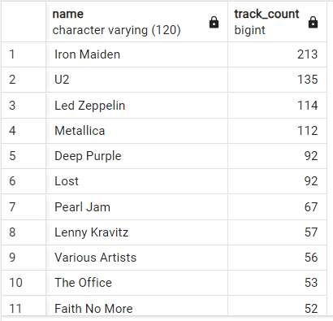
OUTPUT

Slide 23
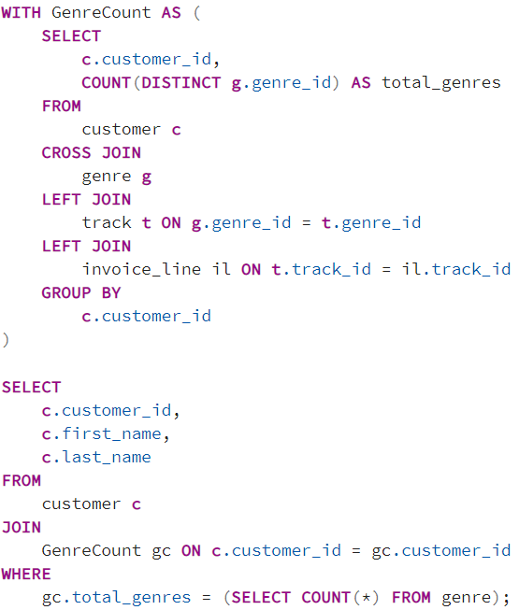
5. Identify customers who have made purchases in every genre available. Return customer details such as customer_id, first_name, and last_name.

Slide 24
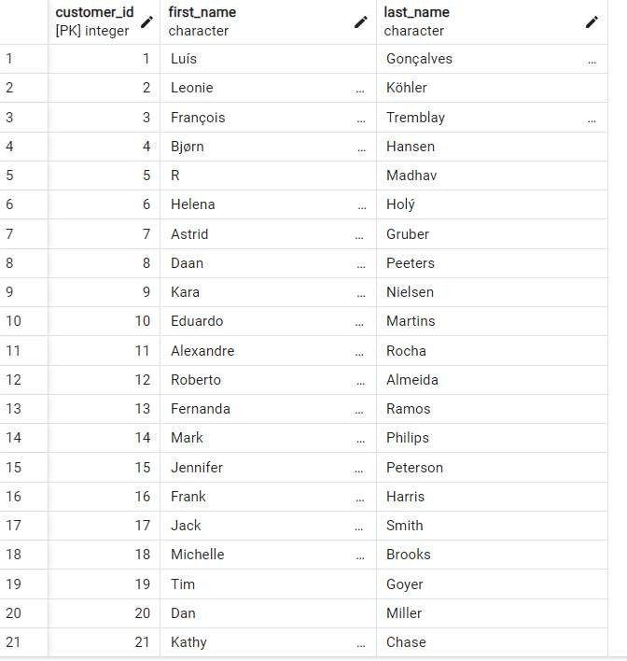
OUTPUT

Slide 25
QUESTION SET 3 – ADVANCED

Slide 26
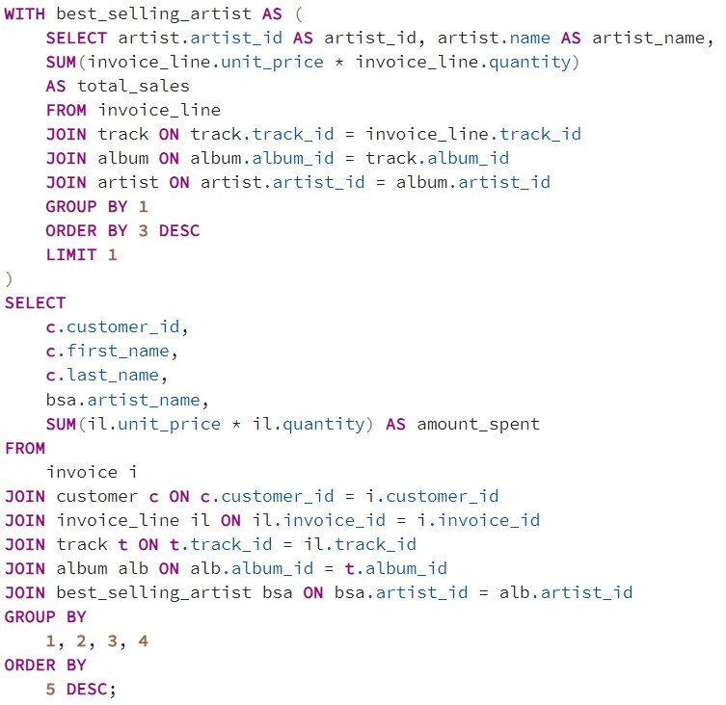
1. Determine the amount spent by each customer on artists, returning customer name, artist name, and total spent.

Slide 27
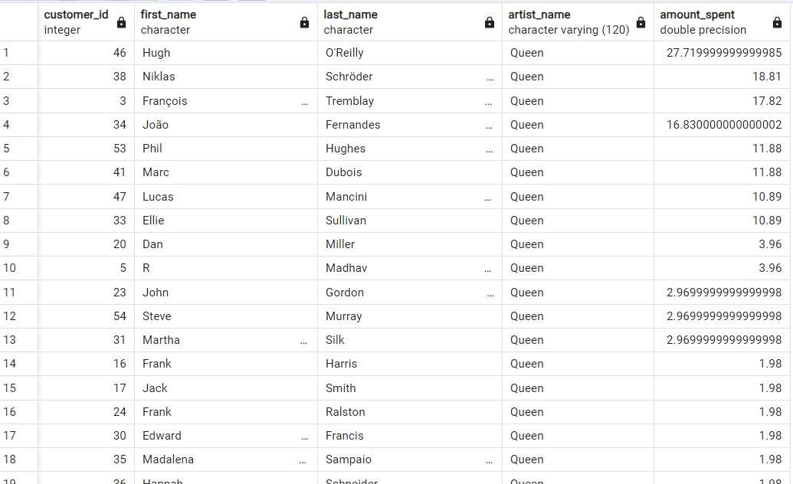
OUTPUT

Slide 28
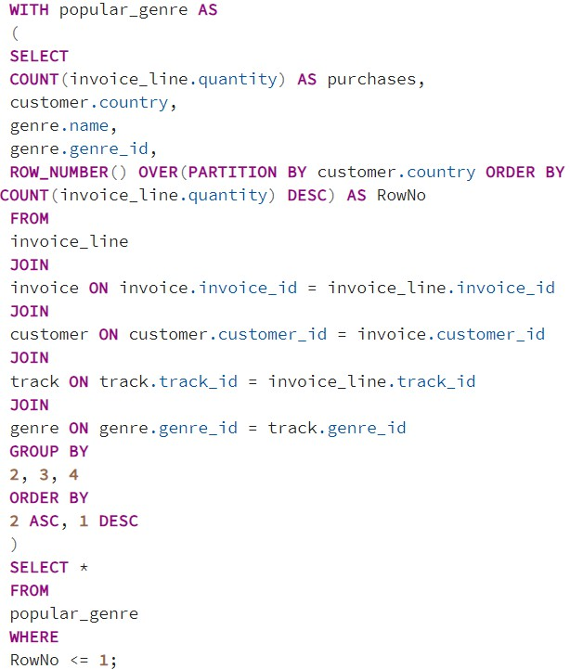
2. Determine the most popular music Genre for each country, considering the genre with the highest number of purchases.

Slide 29
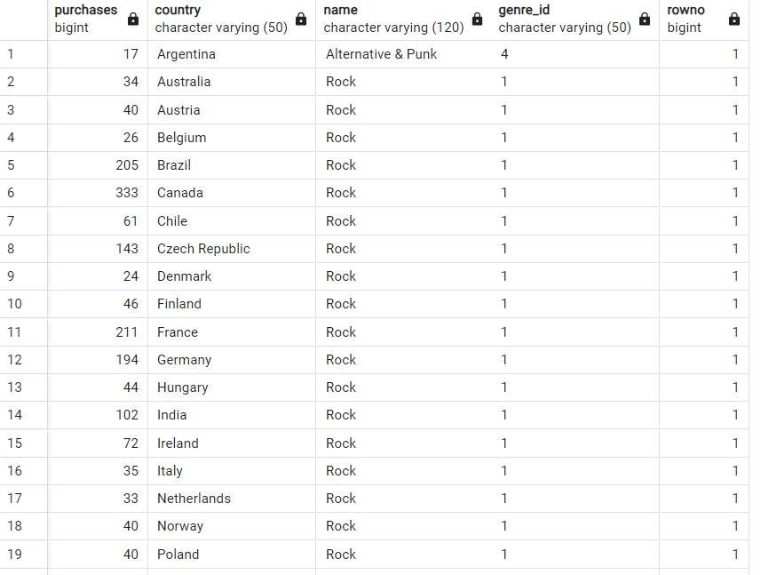
OUTPUT

Slide 30
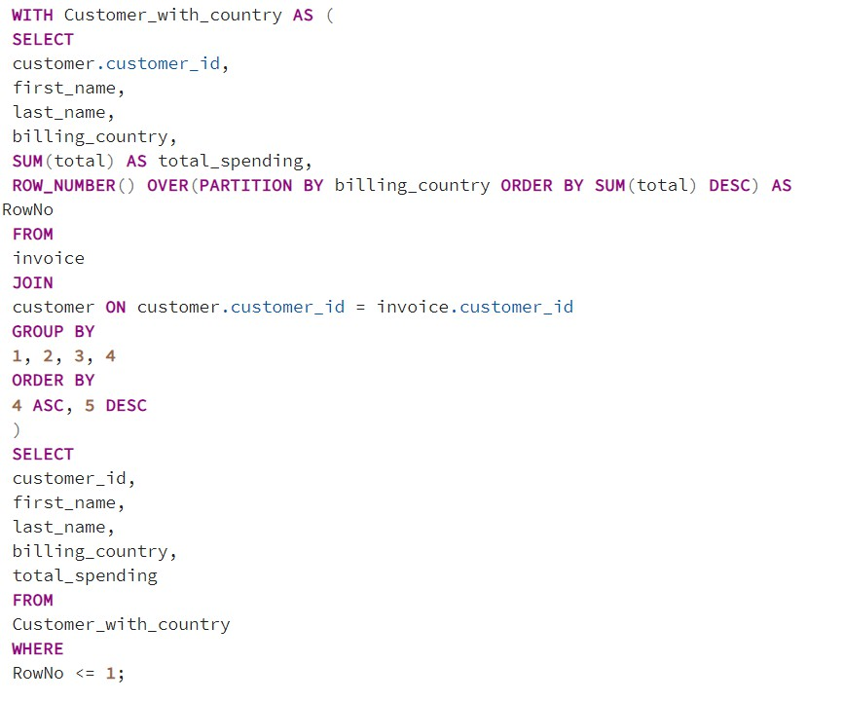
3. Identify the top-spending customer for each country and their total expenditure.

Slide 31
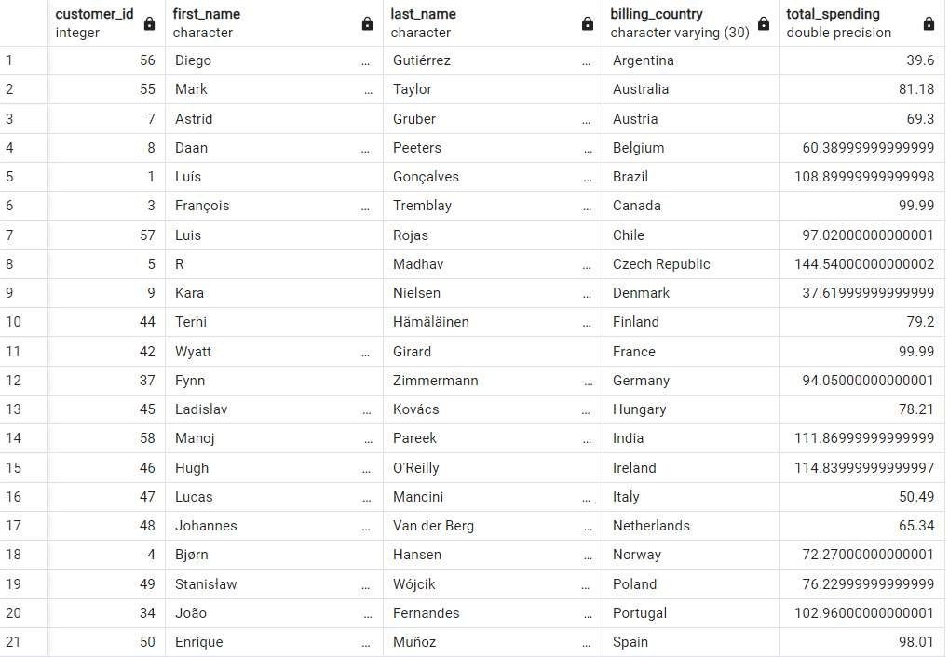
OUTPUT

Slide 32
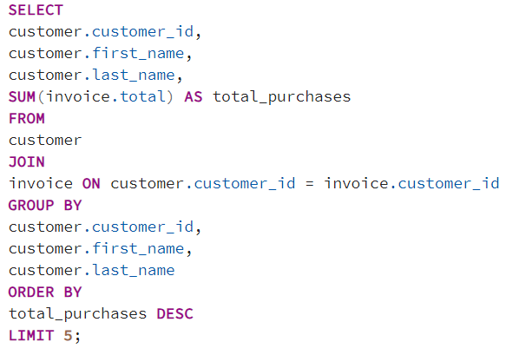
4. List the top 5 customers who have made the highest total purchases.

Slide 33
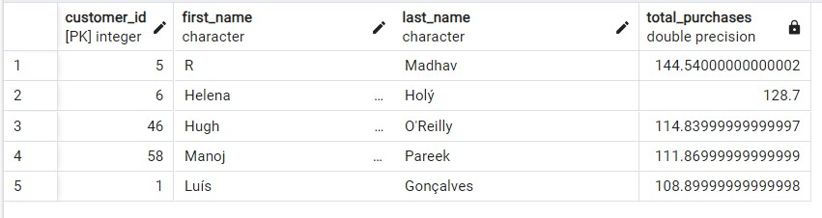
OUTPUT

Slide 34
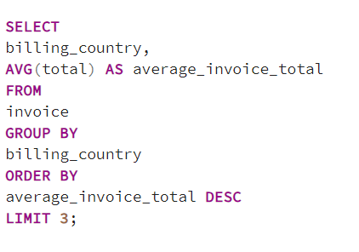
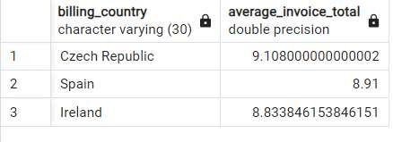
5. Identify the top 3 countries that have the highest average invoice total. Return the country name and the average invoice total.
OUTPUT

Slide 35
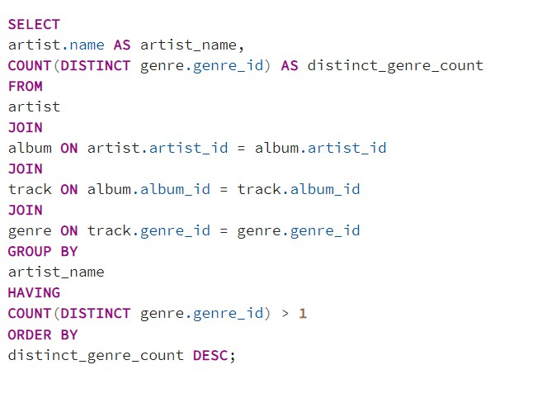
6. Find the artists who have tracks in multiple genres. Return the artist name and the count of distinct genres.

Slide 36
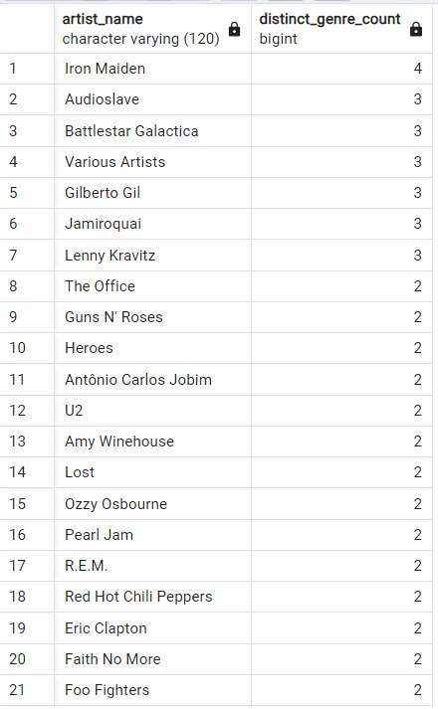
OUTPUT

Slide 37


KEY CONTRIBUTIONS
Operational Efficiency: The project focuses on enhancing the store's operational efficiency by identifying areas for improvement in inventory management, customer engagement, and marketing strategies.
Customer Insights: Through in-depth customer analysis, the project provides insights into customer behaviors, preferences, and spending patterns. This information is crucial for tailoring marketing campaigns and enhancing customer satisfaction.
Genre Performance: The analysis of genre-wise performance helps the store optimize its music catalog, ensuring that the most popular genres are well-represented. This strategic move positively impacts sales and customer engagement.
International Market Exploration: By examining purchasing trends across different countries, the project enables the music store to explore and capitalize on opportunities in various international markets.
Revenue Maximization: The identification of top-spending customers and genres allows the store to focus on high-value segments, maximizing revenue potential.

Slide 38
PRACTICAL IMPLICATIONS
This project transcends theoretical analysis and directly translates insights into practical strategies for the music store.
The application of SQL ensures a robust and scalable solution that aligns with real-world business needs.

Slide 39
FUTURE PROSPECTS
As the music store continues to evolve, the insights gained from this data analysis project will serve as a foundation for ongoing improvements and strategic decision-making. The adoption of data-driven practices positions the store at the forefront of the industry, ready to adapt to changing market dynamics.

Slide 40

CONCLUSION
In conclusion, this SQL Music Store Data Analysis project is not just an academic exercise but a practical and impactful endeavor. By leveraging the power of SQL, it goes beyond mere data querying and transforms raw information into actionable intelligence. The result is a comprehensive understanding of the business landscape, paving the way for a successful and sustainable future for the music store.

Slide 41



THANK YOU

